Slide 1
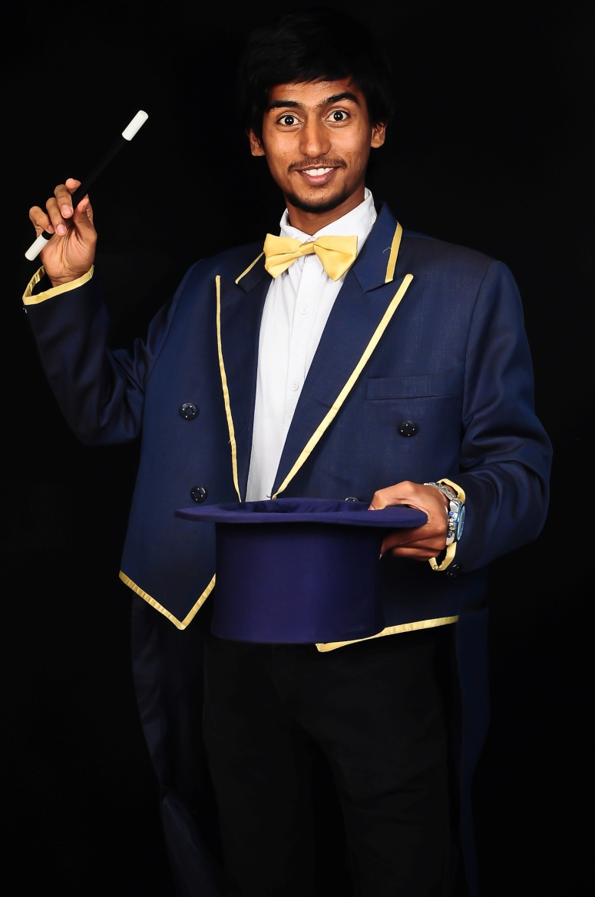
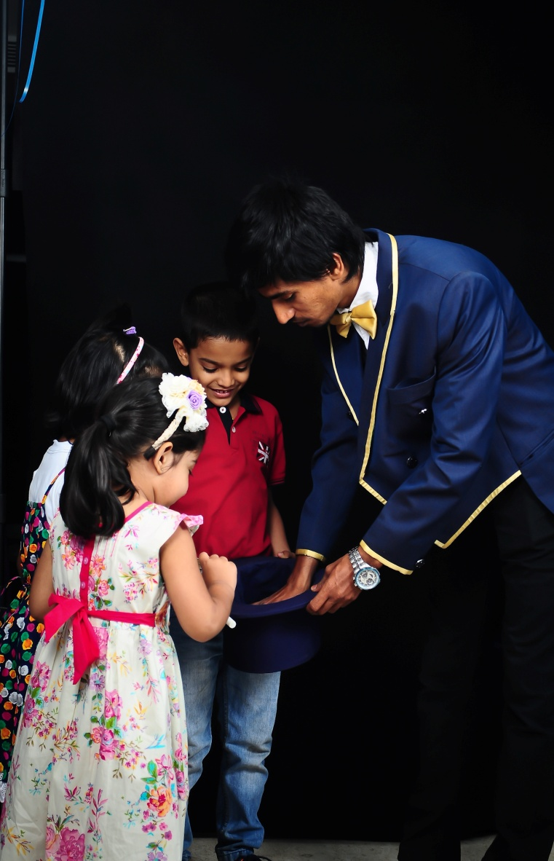
Magician Idris

Slide 2
I, magician idris born in 1994,basically from Bangalore moved into this profession to rock the world of entertainment. I’m a Award winner in IMA ( International magic academy ) ,There are tricks in all trades but mine is a trade of all tricks
I bring elegance, enthusiasm and versatility with me to make an event awesome and successful.
DOB :27th march
Height : 5.5 ft
Languages Known : English, Kannada, Hindi.
E-mail : magicianidris@gmail.com

Slide 3
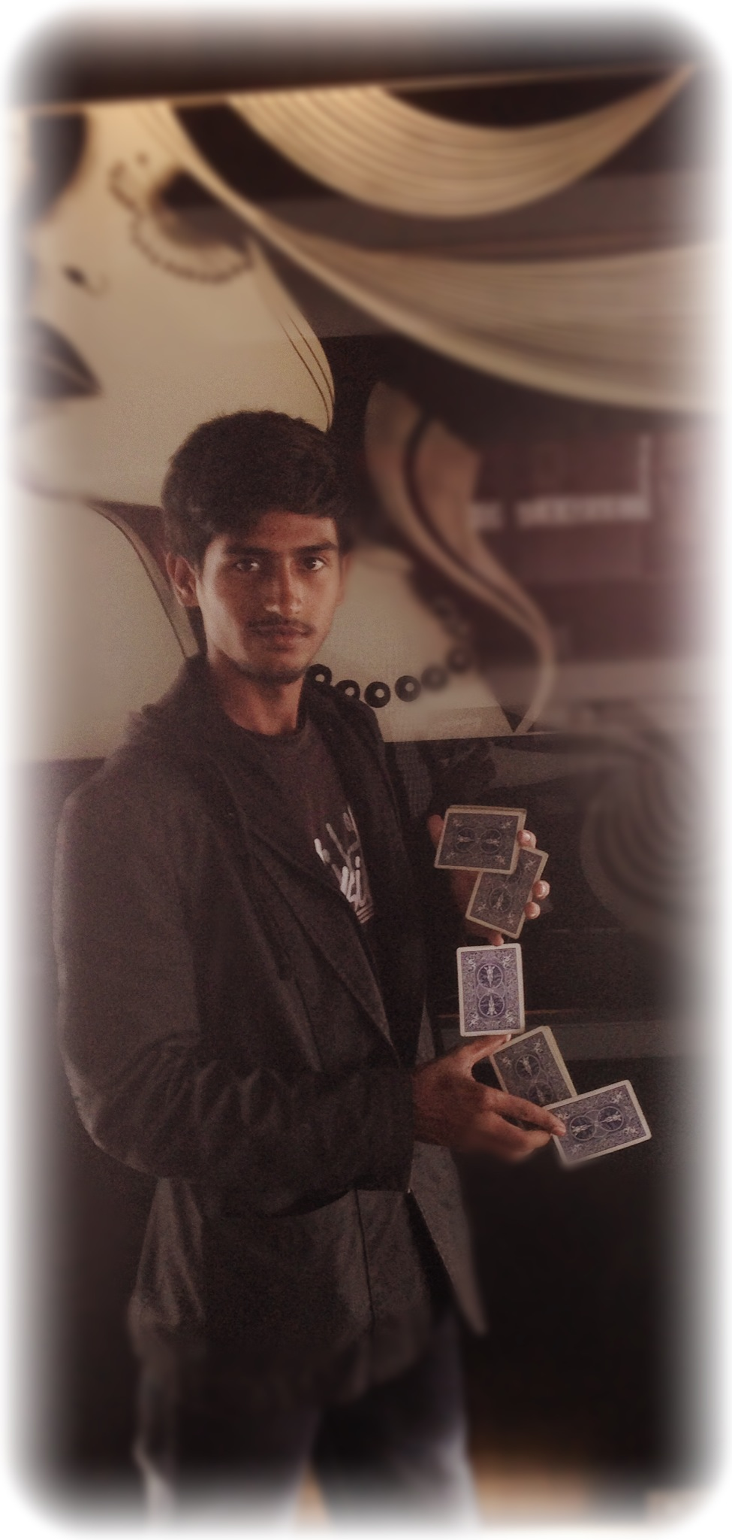
Work I do
CELEBRITY EVENTS/ CONCERTS
CORPORATE DAY OUT
GAME SHOWS
BIRTHDAY PARTIES
AWARD CEREMONIES
FASHION SHOWS
ROAD SHOWS

Slide 4
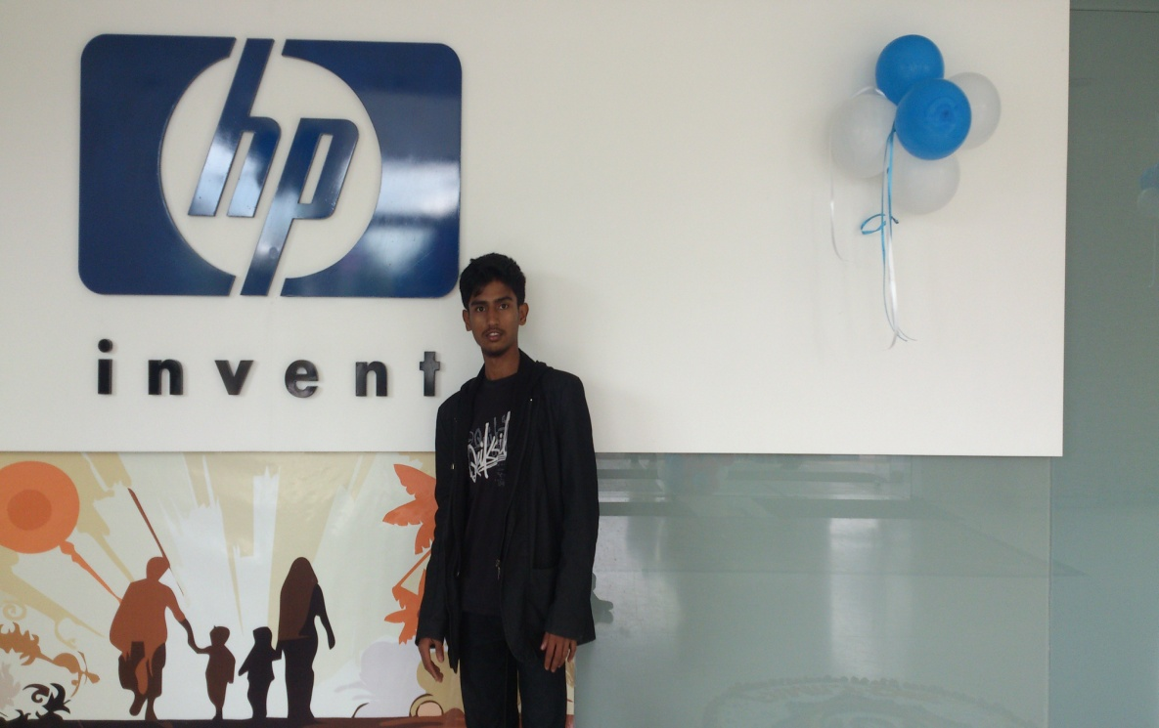
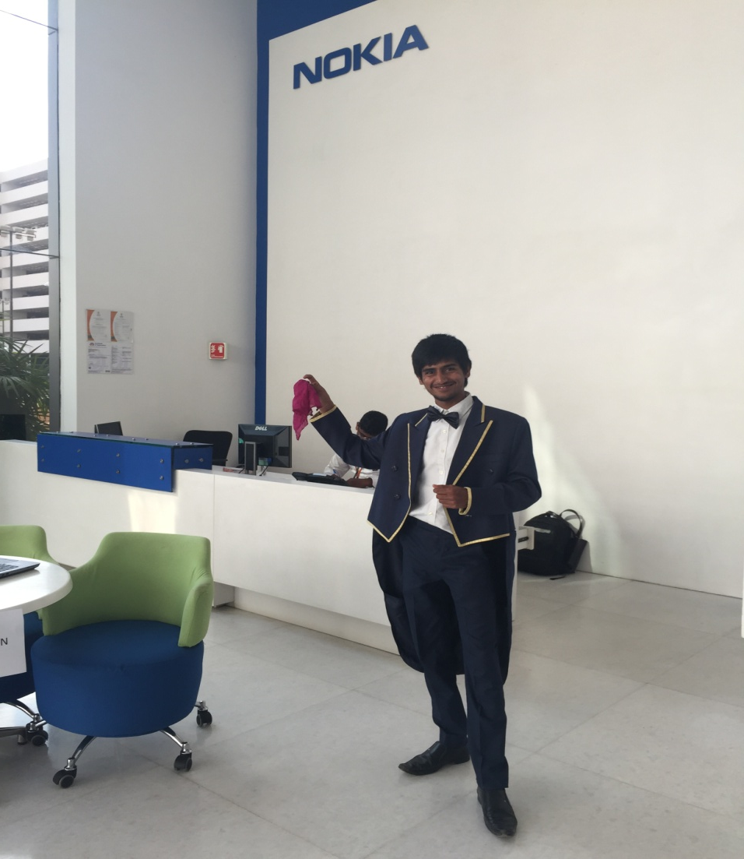
Worked For
NOKIA
HP
CANDYMAN
AMC-CITY INSTITUTIONS
CLUB CABANA
BANGALORE CENTRAL
RELIANCE TRENDS
MARUTHI SUZUKI
HONDA

Slide 5
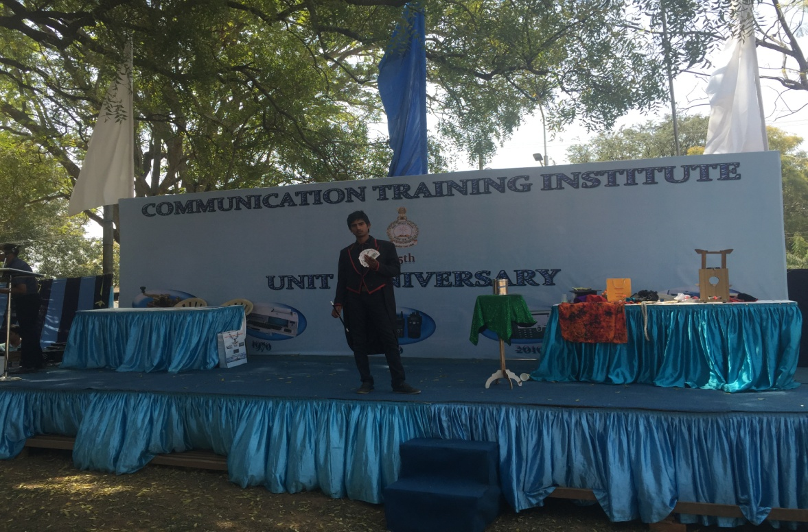
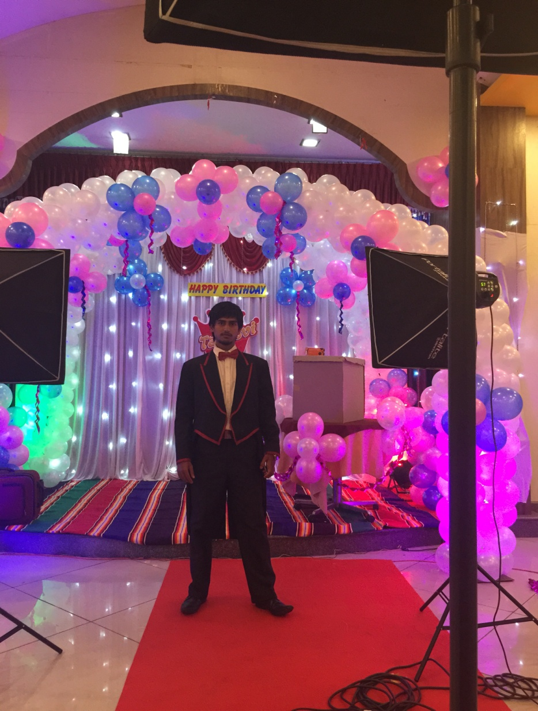
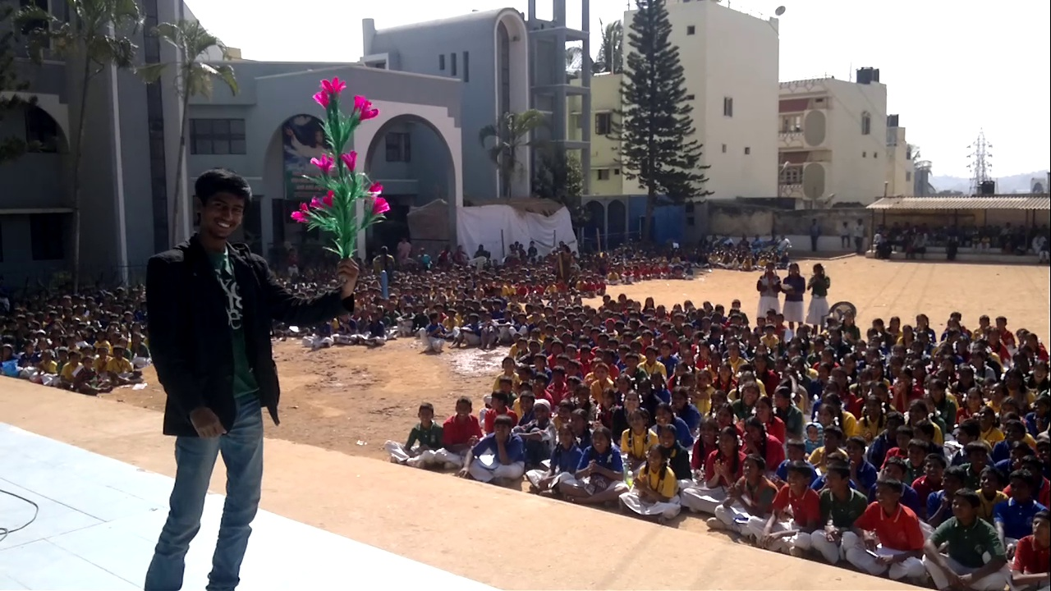
Also Worked For
Family Get together
Birthday Parties
Annual meets
College events
School Activities
College Fests

Slide 6
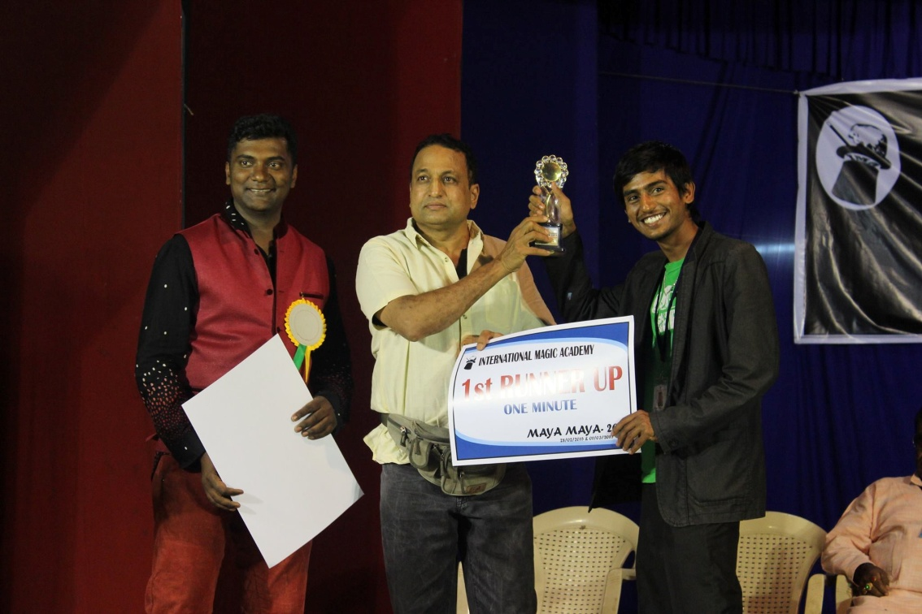
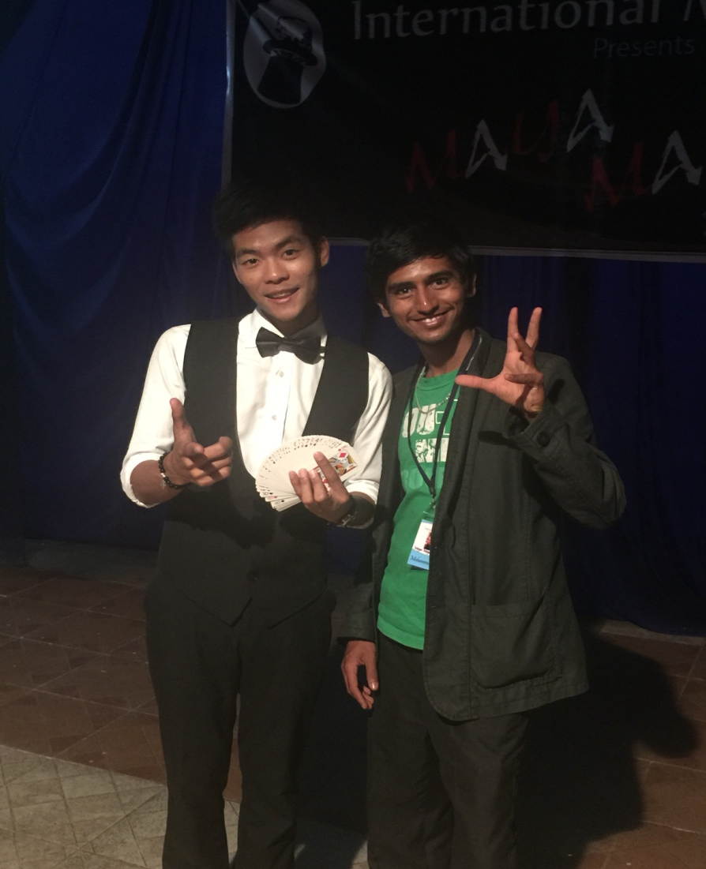
Idris magician
Receiving award from uday jadugaur
Idris with a foreign magician

Slide 7
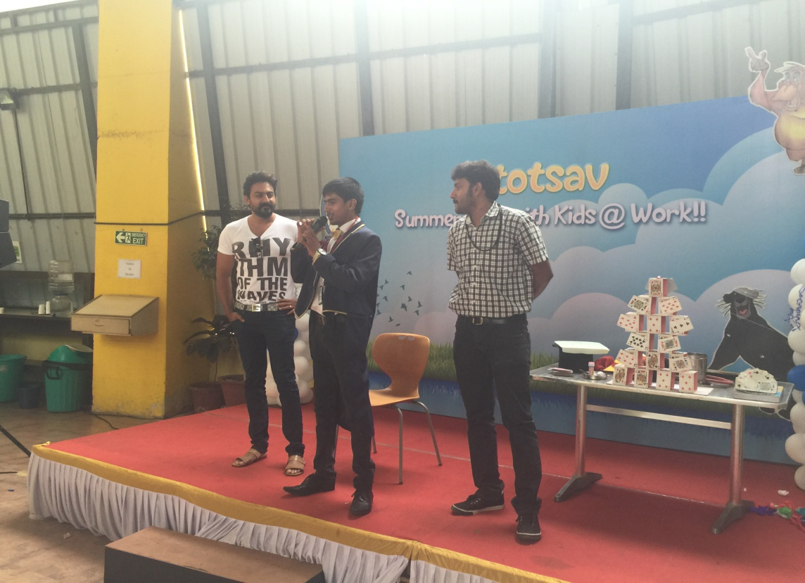
COLLEGE FESTS

Slide 8
GET TOGETHER

Slide 9
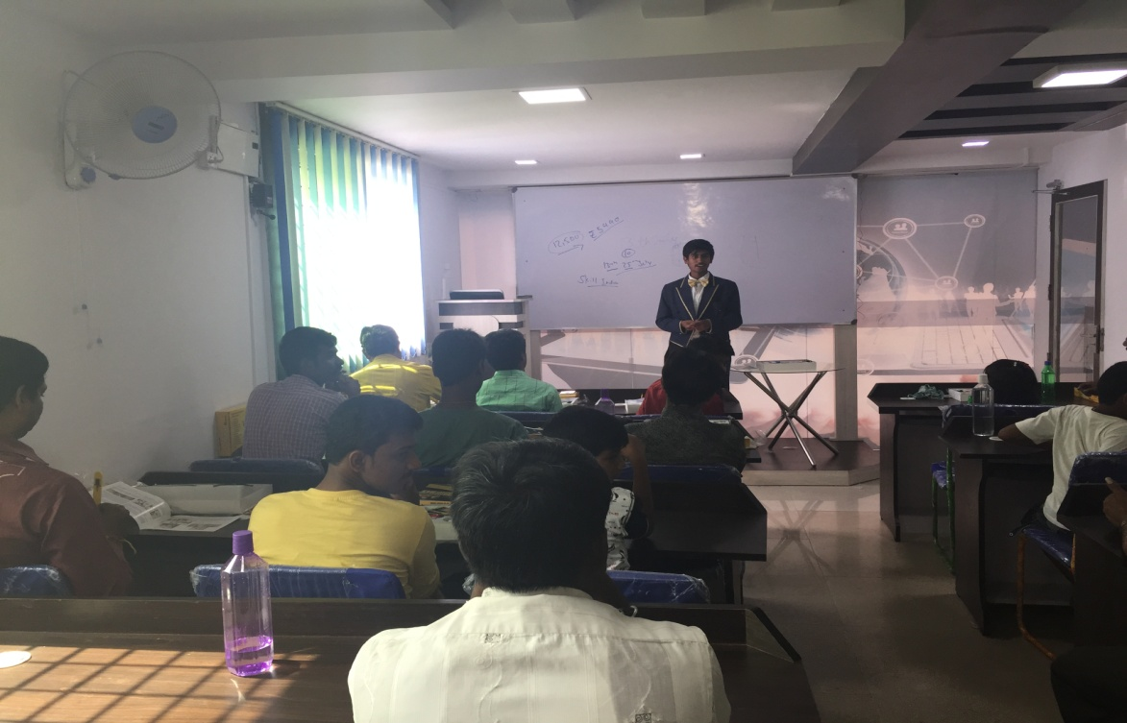
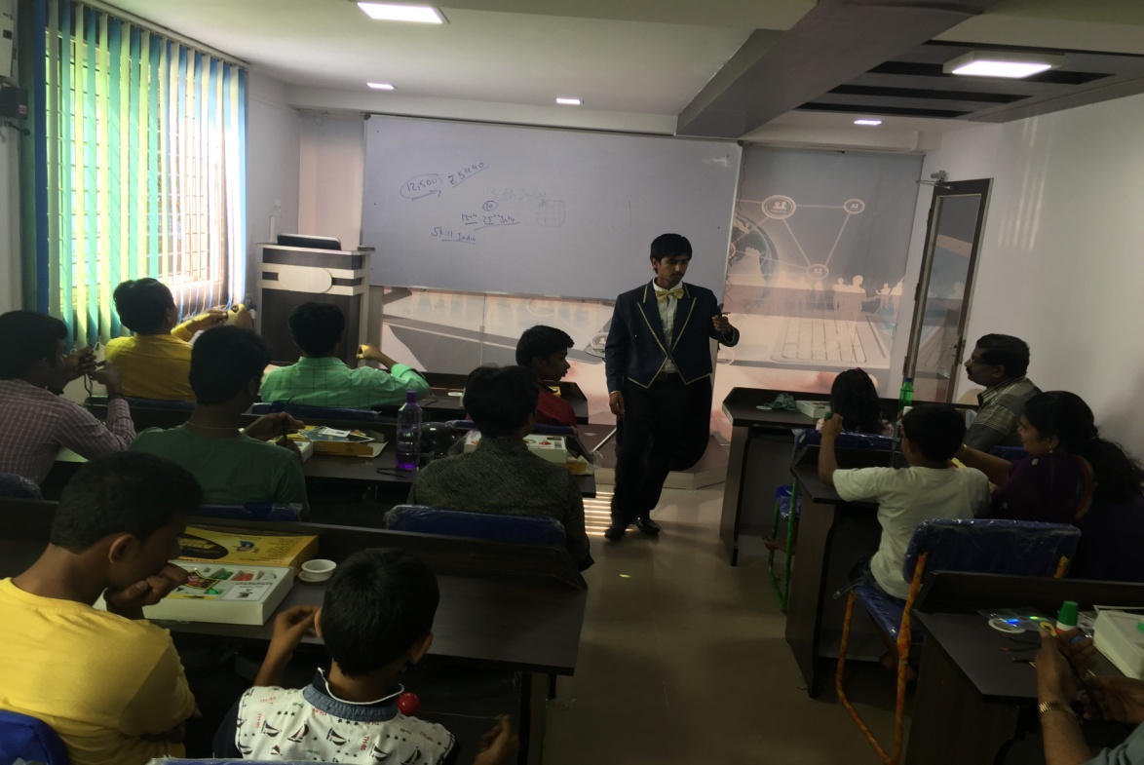
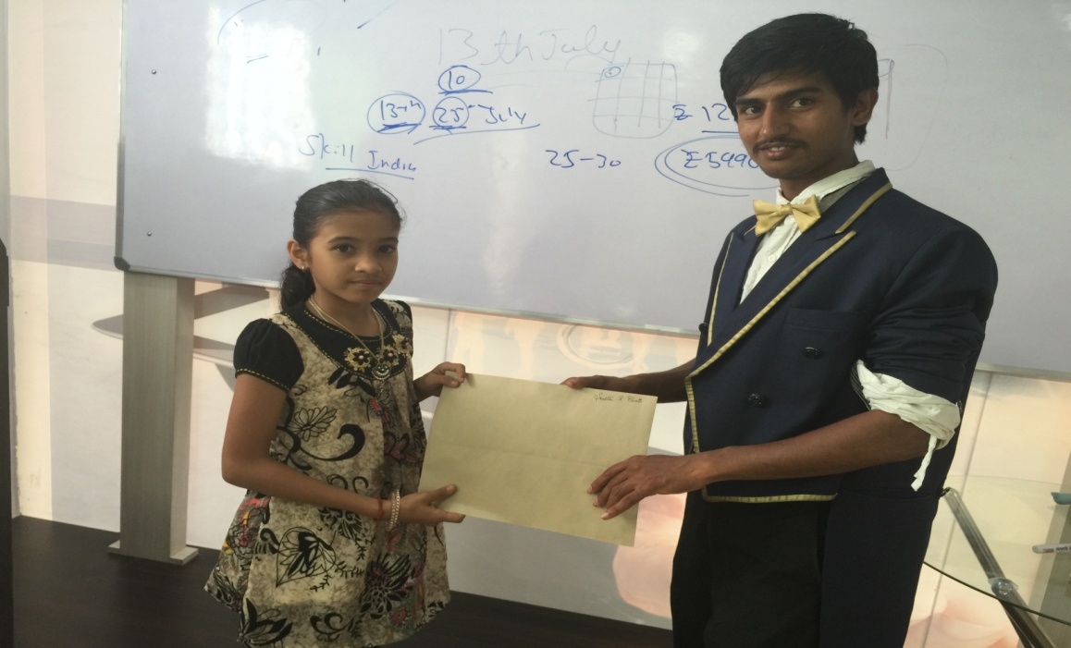
WORKSHOPS ON MAGIC

Slide 10
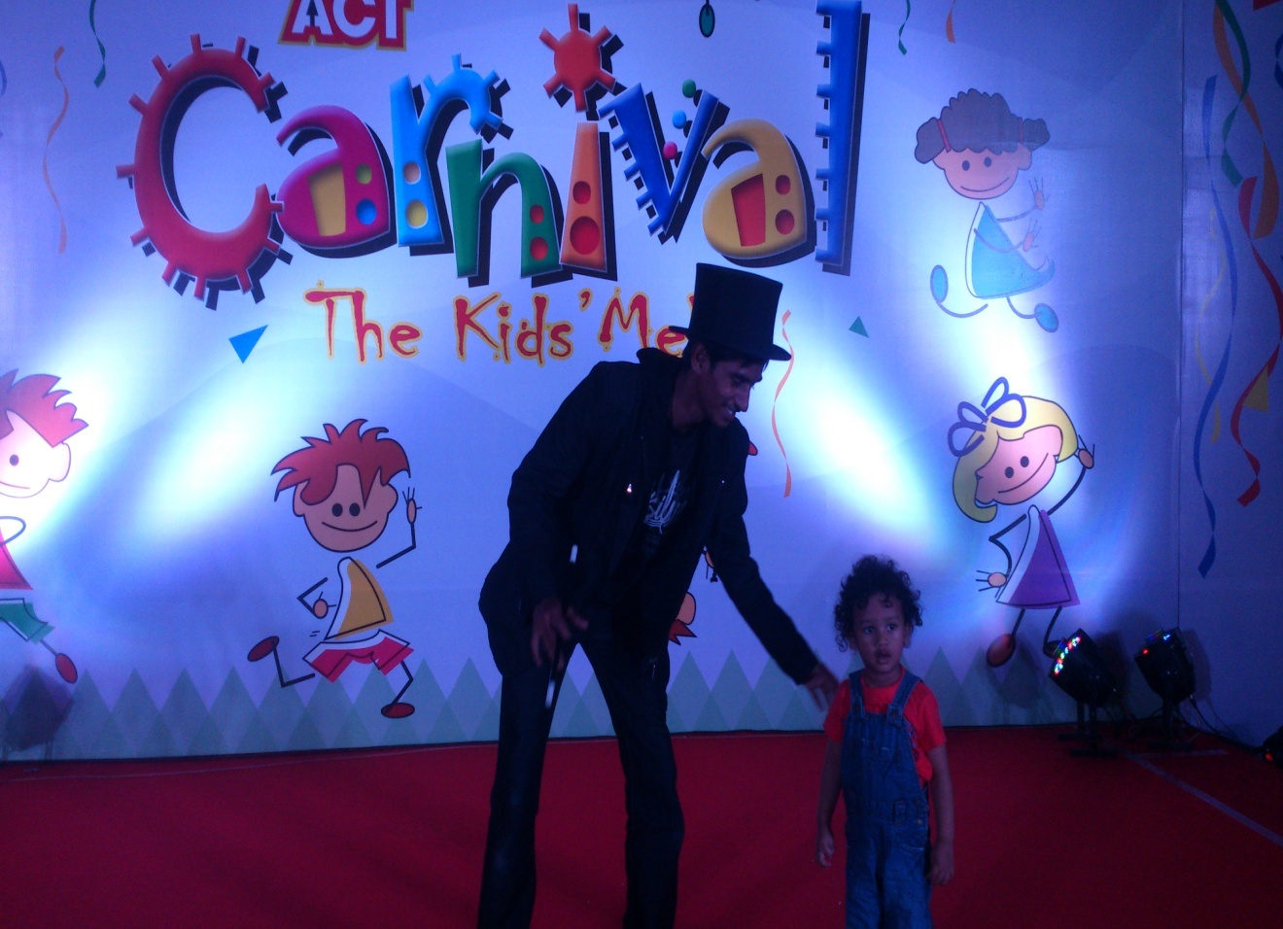
WEEDINGS AND CARNIVALS

Slide 11
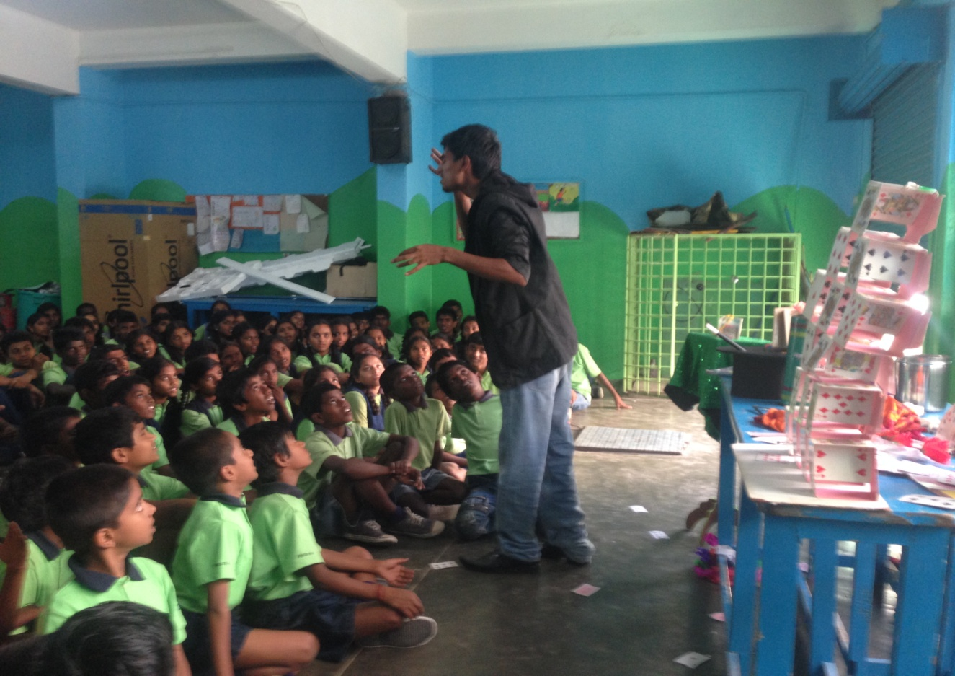
School functions

Slide 12
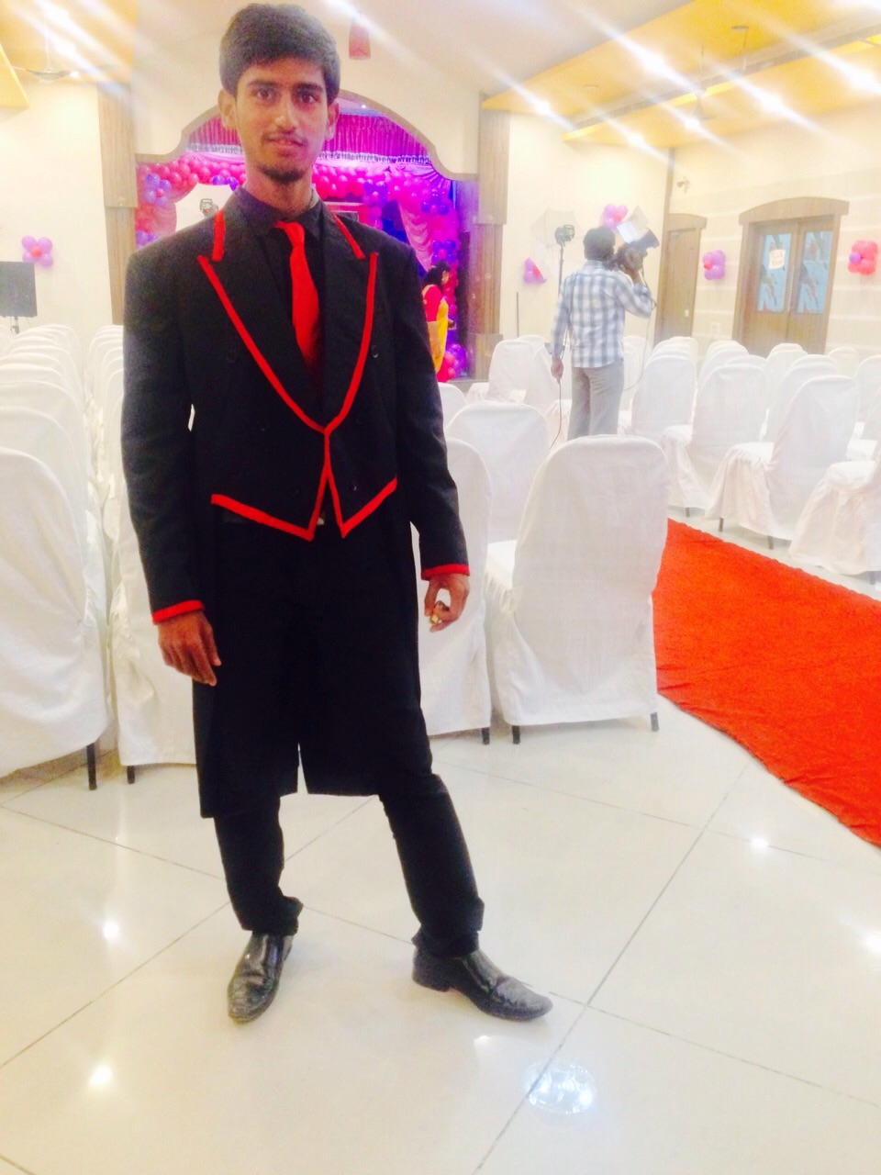
CONTACT ME
PH.NO: +91 8904178561
E-MAIL
magicianidris@gmail.com
WEBSITE
www.magicianidris.com

